Slide 1


Variables and Constants
Chapter 3

Slide 2
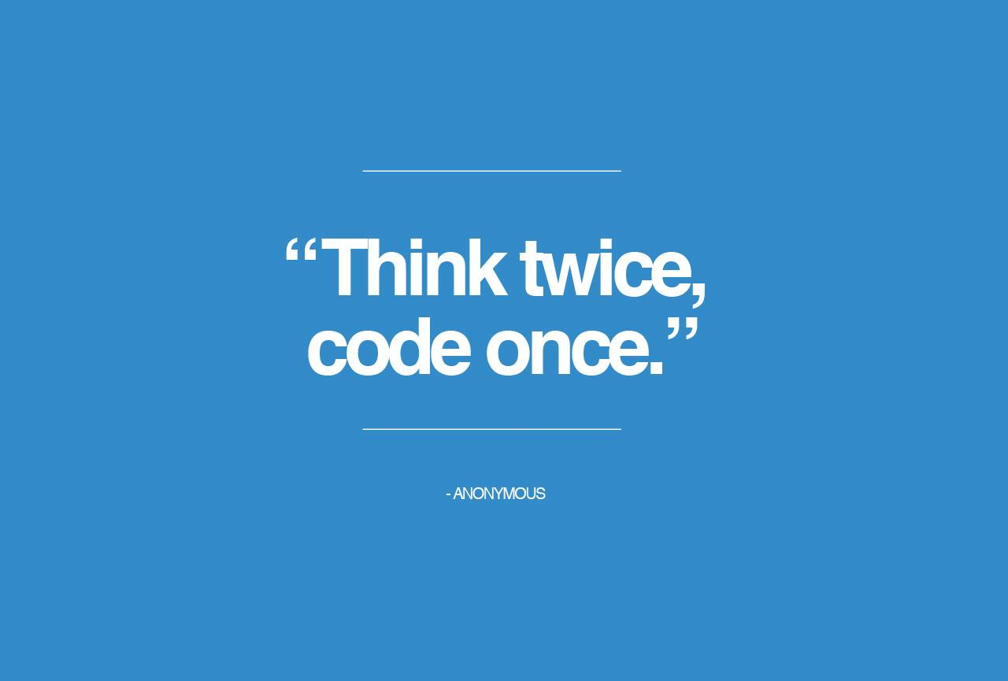
Coding the Algorithm
Refers to the process of translating the algorithm into a language that the computer can understand

Slide 3
Begin by ---
Assigning names to every
input item,
processing item and
output item.
Then, assign a data type and initial value.

Slide 4
Internal Memory Definitions
Each memory location has a unique internal address.
Each memory location can only hold one item.

Slide 5
Declaring a memory location definition
In C++ this is done with one statement that declares the name, data type, and initial value.
Names are descriptive because they are easier to remember and help self-document code.

Slide 6

Types of memory locations
Variables and Named Constants

Slide 7

Variables
Memory location whose value can change during runtime (when the program is running)

Slide 8
Named constant
Cannot change during runtime
Example: PI = 3.14

Slide 9
Memory locations
Every memory location declared must have a name or identifier that is descriptive
A good name is one that is meaningful when you name it and years later.

Slide 10
C++ Rules
Begin with a letter
Contain only letters, numbers and underscore
No punctuation marks, spaces or special characters
Cannot be a keyword (reserved word)
Names are case sensitive
Discount and discount might look alike, but are different in C++

Slide 11
Common guidelines
Use uppercase letters for named constants
Use lowercase for variables
If the name is more than one word for a named constant, use the underscore to separate the names.
TAX_RATE
If the variable name has two words, use the camel case:
grossPay

Slide 12

Why are these invalid names?
2011sales
end Balance
first.name
int
RATE%

Slide 13
Why are these invalid names? Answer
2011sales – starts with a number
end Balance – has a space
first.name – has a decimal
Int – key word
RATE% - cannot use percent

Slide 14
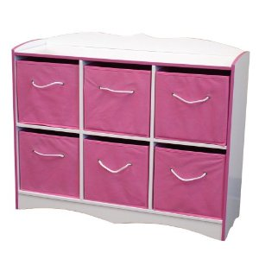
How many items can a memory location store at one time?

Slide 15

Answer: ONE

Slide 16
Which of the following is correct for the quantity variable?
quantity
QUANTITY
Quantity
Any of the above

Slide 17
Answer: Which of the following is correct for the quantity variable?
quantity
QUANTITY
Quantity
Any of the above

Slide 18
Which of the following is a valid name for a memory location?
jan.Sales
2ndQuarterIncome
COMMISSION_RATE
march$

Slide 19
Answer: Which of the following is a valid name for a memory location?
jan.Sales
2ndQuarterIncome
COMMISSION_RATE
march$

Slide 20
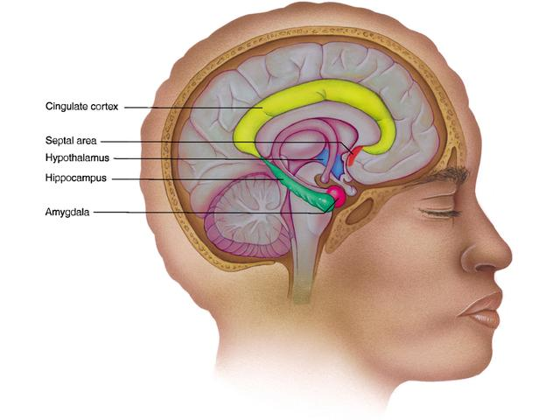
What are the 2 types of memory locations a programmer can declare?

Slide 21
Answer:
Named Constants and Variables

Slide 22
Fundamental data types in C++
short
int
float
double
bool
char
These are basic types built into C++
Also called primitive or built-in

Slide 23
string data type
User-defined data type
A class: a group of instructions that the computer uses to create an object.
In this case, the class creates a string variable which is an object with zero or more characters.

Slide 24
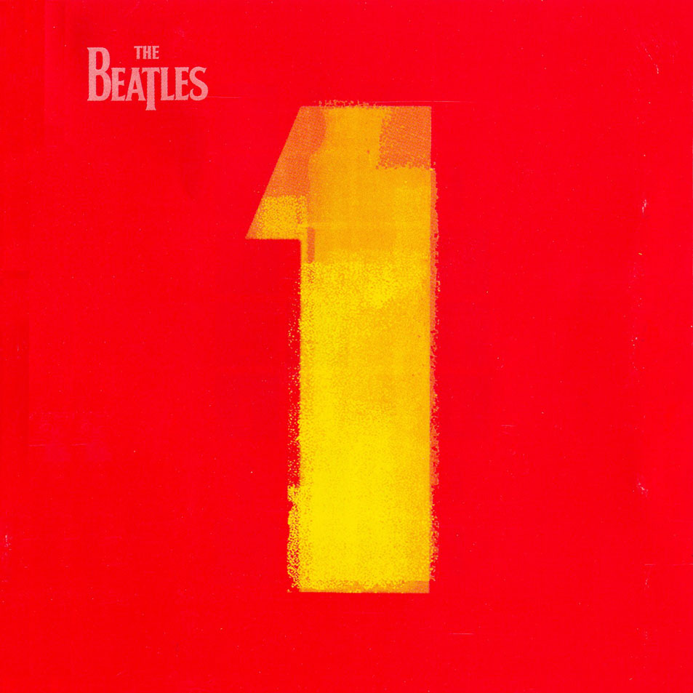
char data type
Can only store one character like a letter or number or symbol.
It does not store a person’s name.

Slide 25
short and int
Store integers only.
A whole number does not contain decimals.
The difference between short and int is the storage size of the variable.

Slide 26
Real numbers
Float
Double
Difference is range.
Double is more precise.
Not all numbers can be represented with accuracy to the penny.

Slide 27
Internal memory
Binary number system
0, 1

Slide 28
ASCII
Contains a specific numeric code for each character on the keyboard.
ASCII is then converted to binary.

Slide 29
Data type
Determines how the computer interprets a memory location’s existing data.

Slide 30
True or false
The string data type is one of the fundamental data types?

Slide 31
Answer: True or false
The string data type is one of the fundamental data types?

Slide 32
In the binary number system the decimal number 32 is represented as
10000
10001
100000
None of the above

Slide 33
Answer: In the binary number system the decimal number 32 is represented as
10000
10001
100000
None of the above

Slide 34
What is the ASCII code for the lowercase letter b and how is it represented in the computers internal memory?

Slide 35
Answers:
98
01100010

Slide 36
Which data type can store a real number?
double
int
float
Both a and c

Slide 37
Answer: Which data type can store a real number?
double
int
float
Both a and c

Slide 38
Initial values
Called initializing
bool is done with “true” or “false”
All others use a literal constant

Slide 39
Literal constant
Item of data that can appear in a program instruction and be stored in a memory location.
Must match the data type of the memory location to which it is assigned.

Slide 40
examples
Memory locations which are short or int should have integers assigned to them. Example: int number = 0;
Memory locations which are float or double should have real numbers assigned to them. Example: double rate = 0.0;
Integers and real numbers are called numeric literal constants.
They can contain a minus sign, plus sign, numbers, and the decimal point.
Also the letter E for exponential notation

Slide 41
Numeric literal constants
Cannot contain a space, comma, or special character
No $ or %
A numeric literal constant with no decimal is an int
A numeric literal constant with a decimal is a double data type

Slide 42
Character literal constant
Used to initial char data types
Enclosed in a single quote
‘x’
‘ ‘

Slide 43
String literal constant
Used for a string memory location
Uses double quotation marks
“hello”
“” (no space between) also called empty string

Slide 44
Assigning a value to a memory location
1. Computer compares the values’ data type with the memory location’s data type
2. If they don’t match, then the computer does a implicit type conversion
3. Example;
IF YOU ASSIGN AN INTEGER 9 TO A REAL NUMBER, THE 9 BECOMES A 9.0
4. When a value is converted from one data type to another that can store LARGER numbers, it is promoted.

Slide 45
demoted
If a int variable is declared and you use a real number to initialize the variable, then the value is demoted:
Example: int years = 1.5
Then 1.5 becomes 1 and the value is demoted!

Slide 46
How to initialize:
short and int = 0
double and float = 0.0
char = ‘ ‘
string = “”
bool = true or false

Slide 47
Declaring a memory location
Use a statement
datatype variablename = initial value;
Use the correct syntax! (rules of the programming language)

Slide 48
Examples of initialization
int age = 0;
double price = 0.0;
bool paid = false;
char grade = ‘ ‘;
string company = “”;

Slide 49
Naming a named constant
const datatype constantname = value;
const double PI = 3.14;

Slide 50
Which of the following is a character literal constant?
‘56’
‘%’
“a”
Both a and c

Slide 51
Answer: Which of the following is a character literal constant?
‘56’
‘%’
“a”
Both a and c

Slide 52
Which of the following is a string literal constant?
“$”
“Good Morning”
“”
All of the above

Slide 53
Answer: Which of the following is a string literal constant?
“$”
“Good Morning”
“”
All of the above

Slide 54
If you assign the number 10.25 to an int variable, what will the computer store in its memory?

Slide 55
Answer: If you assign the number 10.25 to an int variable, what will the computer store in its memory?
10

Slide 56

Write a C++ statement that declares and initializes an int variable named population.

Slide 57
Answer: Write a C++ statement that declares and initializes an int variable named population.
int population = 0;

Slide 58
Write a C++ statement that declares the MAX_PAY name constant. It should have double data type and the number 25.55.

Slide 59
Answer: Write a c++ statement that declares the MAX_PAY name constant. It should have double data type and the number 25.55.
const double MAX_PAY = 25.55;

Slide 60
IF you earn $10.25 per hour and worked 20 hours, how much less would you be paid if your hourly rate was inadvertently assigned to an int variable?

Slide 61
You make $5 less!
double hourlyRate = 10.25
Pay = 20 * hourlyRate
Pay = 20* 10.25
Pay = 205.00
int hourlyRate = 10.25
Pay = 20 * hourlyRate
Pay = 20* 10
Pay = 200

